Slide 1

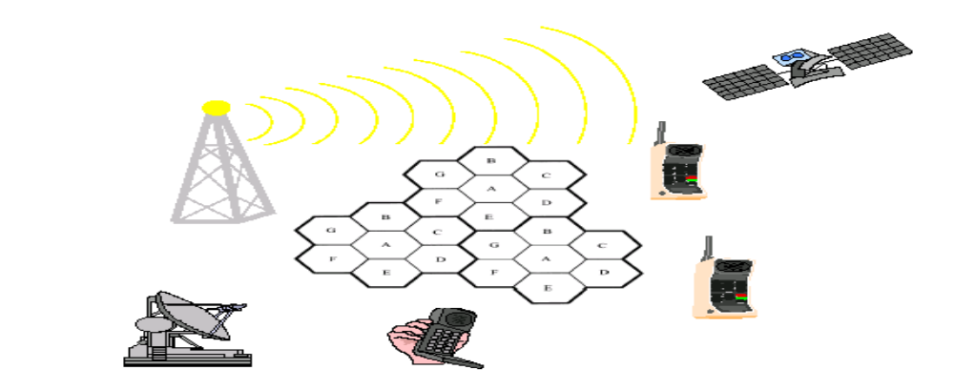
Chapter One
INTRODUCTION

Slide 2
Introduction
Definition of wireless network :
    A wireless network is a computer network that uses wireless data connections between network nodes.
    It is Un-tethered, no physical wire attachment
    It is a communication over wireless link
    Cellular network: telephone system that uses a number of short-range radio stations to cover the area that it serves.
    The signal being automatically switched from one station to other as user travel.
Definition of mobility:
    Mobility: handling the mobile user who changes point of attachment to network.
    user mobility: users communicate anytime, anywhere, with anyone
    Device portability: devices can be connected anytime, anywhere to the network.
Notes:
Network a set of interconnected device that work together to achieve something (sharing)
Managing user and device which not physical attached to each other but in motion .
WMN The art of connecting mobile devices to the network with out having a physical connection between devices

Slide 3
Introduction …
Wireless mobile network: The art of connecting mobile devices to the network with out having a physical connection between devices.
The need for mobility creates the need for integration of wireless networks into existing fixed network environments:
  Local area networks: standardization of IEEE 802.11b/g/a
  Internet: Mobile IP extension of the internet protocol IP
  wide area networks: e.g., internetworking of 3G and IP
Notes:
Internet wwn. Use TCP/ip

Slide 4

Evolution of mobile radio communication
Guglielmo Marconi invented the wireless telegraph in 1896
  Communication by encoding alphanumeric characters in analog signal
  Sent telegraphic signals across the Atlantic Ocean
Communications satellites launched in 1960s
Advances in wireless technology
  Radio, television, mobile telephone, communication satellites
More recently
  Satellite communications, wireless networking, cellular technology

Slide 5
Evolution of mobile radio Continued…
Radio (infrared) propagation
  Reflection, refraction, diffraction
  Shadowing, fading, multipath
Time-varying channel
  Dynamic channel capacity, time-varying interference
  Location dependent and time varying channel errors: Channel coding, source coding, modulation
Narrow bandwidth
  Limited radio frequency: scarce radio resources
  Cellular concept
Broadcasting
  Sharing the medium
  Less secure

Slide 6
Wireless vs. Mobile
Wireless ≠ Mobile
Wireless systems (Nomadic systems)
  WiFi
  Bluetooth
  Zigbee
  Fixed WiMAX
Mobile wireless systems
  Cellular systems (2G, 3G)
  WiBro / mobile WiMAX
Notes:
Elements of wireless network(Host,BS and links )

Slide 7
Evolution of Mobile Communication..
1G (1st Generation) -1980s
  Analog cellular telephones
  Based on FDMA
  Provide only voice service
  Use cellular technology like AMPS,TACS
  Drawback: Exposed to noisy and not include security issue
2G (second generation)-1990
  Digital cellular telephones
  Contain two track first use FDMA+TDMA while second use CDMA
  Provide higher secure voice call +SMS and Limit mobile data service
  Digital modulation
  Data compression
  Error control
  Soft handoff(make-before-break)
Notes:
TACS:total access communication
Cellular: telephone system that uses a number of short-range radio stations to cover the area that it serves, the signal being automatically switched from one station to other as user travel.
Digital modulation the process of encoding a digital information signal to the ampilitude phse or frequency transmitted signal
Varing one or mor periodic wave form carrier signal
Hard handoff : hard is break-before-make
IS-36(interim standard extend th function of dual mode standard)= digital traffic channel or analog voice channel, ACC and add digital control channel
Dual mode system use ACC(ONLY) to control transmission of voice and traffic channel

Slide 8
Evolution of Mobile Communication..
  Contain three systems
    IS 136 TDMA (1994~) add digital control channel to dual mode standard
    GSM (1991)
    IS-95 CDMA (1996) (The first commercial CDMA system was launched in Korea)
    800-900MHz , 1.7-1.9GHz (PCS)
    2G services are frequently referred as Personal Communications Service
    Dis advantages: Network were circuit switched
    :Not design for providing efficient data service

Slide 9

Evolution of Mobile Communication…
3G standard groups divided
  Enhanced based on CDMA
    Multimedia
    WCDMA/FDD (1998) -> 3GPP Release 7
    IMT (International Mobile Telecommunication) 2000
      Meaning of 2000: global roaming around 2GHz
      Finalized its standard: 3GPP Release 7
      Provide peak down load speed 2Mbps average data rate 384Kbps
      Circuit switching for voice/SMS and packet switching for data services.
3GPP (3rd generation partnership project)
  European, Korean, Japanese service providers
  UMTS (Universal Mobile Telecommunication System)- WCDMA, 2GHz (bandwidth 5MHz)
Notes:
Wimax;worlid wide interoprablities macrowave access
FDD(frequency division duplex): allow uplin and downlink at the same time but different frequency
UMTS(group of radio detchnology+3G cellular network) use WCDMA
LTE(long term evolution based on GSM and improve speed and capacity) use combination of OFDMA(orthogonal) and SC-FDMA(single carrier)
Wideband CDMA:3rd generation allow both for voice and data speed 384 kbps

Slide 10
Evolution of Mobile Communication…
  Allow up link and downlink at the same time but at different frequency.
  3GPP systems
      GSM
      WCDMA / FDD
      HSDPA (High Speed Downlink Packet Access) support up to 42Mbps
    HSUPA (High Speed Uplink Packet Access) support 11.5Mbps
    LTE
3.5G
        HSPA (High Speed Packet Access), 3GPP
        HSDPA, HSUPA
        WiBro, Mobile WiMAX
        OFDMA

Slide 11
Evolution of Mobile Communication…
4G –enabled by LTE technology
    Support both packet switch and circuit switch
    Realizable mobile broad band
IMT-Advanced
    Full IP-based packet switching
    Data rates: 1Gbps (downlink), 500Mbps (UL)
    Max. spectral efficiency: 30bps/Hz (DL),
    LTE Advanced by 3GPP
      OFDMA
      802.16m (next generation WiMAX)
  5G:Enabled by technology called new radio based on OFDMA
        Enhance mobile broad band (EMBB)
        Ultra- reliable low latency communication(ULLC)
        Massive machine Type communication(MMTC)
Notes:
Allow the AP to allocate whole the channel to single user at a time or partitioning channel to several multiple user simultaneously
3GPP2
US, Korean companies
cdma2000, 800-900MHz/1.7-1.9 GHz
Base station synchronization needed
4G
IMT-Advanced
Full IP-based packet switching
Data rates: 1Gbps (downlink), 500Mbps (UL)
Max. spectral efficiency: 30bps/Hz (DL),
15bps/Hz (uplink) with up to MIMO 8x8
Avg. spectral efficiency: 2.4-3.7 (DL), 1.2-2.0 (UL)
Delay in control plane: 10ms
Two systems approved
3GPP LTE-Advanced
WiMAX-II (IEEE 802.16m)

Slide 12
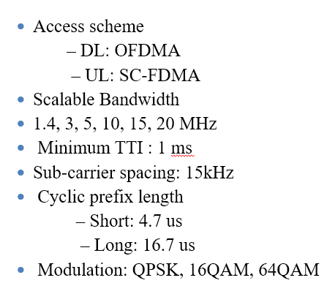
LTE Requirements
Round Trip Latency
  Below 30ms (end-to-end)
  Less than 5ms user-plane latency,
  100ms control-plane latency
Coverage : 5-100km
Spatial multiplexing
  Single layer for UL per UE
  Up to 4 layers for DL per UE
  MU-MIMO supported for
  UL and DL

Slide 13
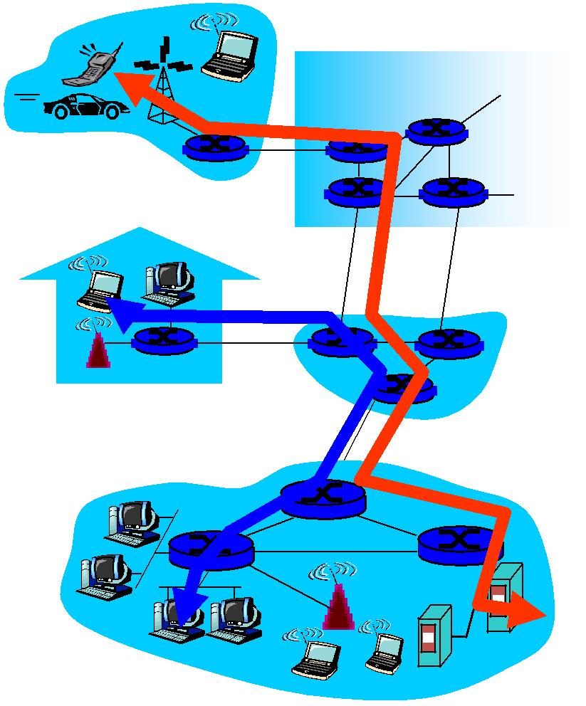
Circuit Switching
Circuit Switching and packet switched communication
uses a dedicated path between two stations
can be inefficient
channel capacity dedicated for duration of connection.
if no data, capacity wasted
set up (connection) takes time
once connected, transfer is transparent

Slide 14
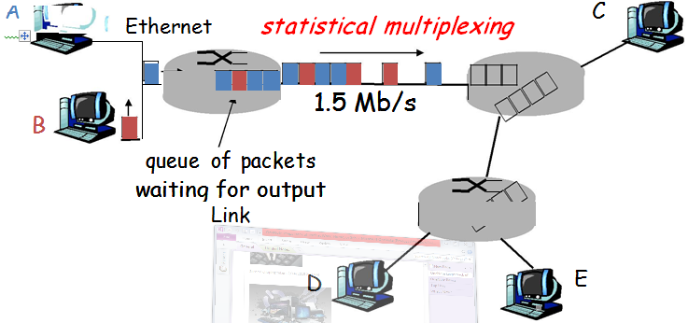
Packet Switching
line efficiency
  single link shared by many packets over time
  packets queued and transmitted as fast as possible
data rate conversion
  stations connects to local node at own speed
  nodes buffer data if required to equalize rates
  packets accepted even when network is busy
priorities can be used
100 Mb/s

Slide 15
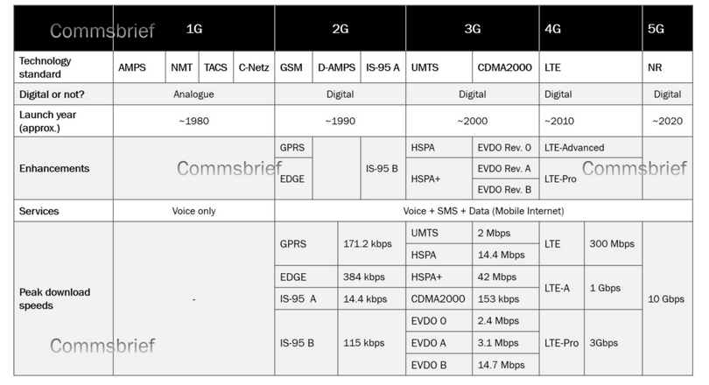
Generalized mobile network generation

Slide 16
Trends in Cellular Radio+Personal Commummication
Personal Communication Services (PCS) or PCN.
    voice + data(PDA)
    wireless internet services
2. Low earth orbit (LEO) satellite communication
3. Indoor Wireless Networking
•WLAN
•Hyper LAN
•Bluetooth(PAN)
3. Future Public Land Mobile Telephone System (FPLMTS)---A worldwide Standard
•3G, 4G
•Software-defined Radio

Slide 17
Personal Communication Services (PCS) or PCN
PCN refers to a wide variety of Wireless access and personal mobility service provided through a small terminal,
The goal is to enable communications at any time at any place and any form.
Business opportunities for such services are tremendous.
Several PCS systems have been developed to meet rapid growth prompted by heavy market demand.
Traditionally, various PCS systems were connected to the Public Switched Telephony System (PSTN) and driven by telephony standards (and at the rate of change of telephony standards).
Today, these systems are increasingly connected to the internet and driven by the internet standards & change at internet speeds.
  Examples include High tier digital cellular systems(Mobile phone systems) for wide spread vehicular and pedestrian services.

Slide 18
Trends Cont’d…
High tier digital cellular systems
    Global system for mobile communication(GSM)
    IS-136 TDMA based Digital Advanced Mobile Phone Service(DAMPS).
    Personal Digital Cellular(PDC)
    IS-95 CDMA based cdma One system.
Low tier telecommunication systems standards for residential, business and public cordless access systems.
    Cordless telephone 2(CT2)
    Digital Enhanced Cordless Telephone(DECT)
    Personal Access Communication Systems(PACS).
    Personal Handy phone system(PHS).
Notes:
High-tier cellular systems such as GPRS provide users high mobility but less bandwidth. On the other hand, low tier wireless systems such as WLAN offer high bandwidth with less mobility.

Slide 19
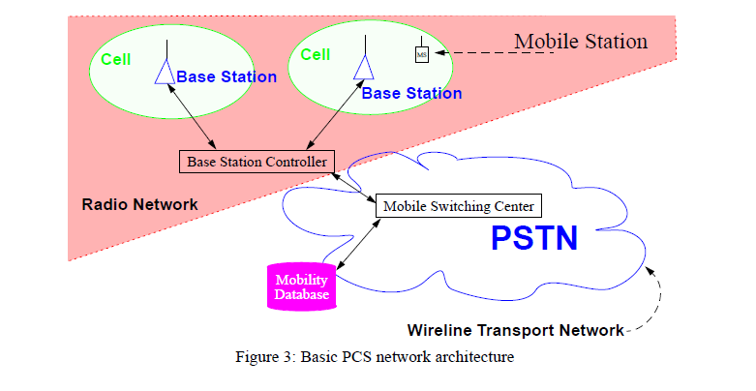
PCS Architecture
Notes:
Paging systems

Slide 20
PCS Architecture…
PCS technology have grown rapidly in the telecommunication industry.
Two most popular are:
Cellular Telephony and Cordless and Low-Tier PCS Telephony.
These Technologies have similar architectures as shown in the above figure.
This Basic architecture consists of two parts, namely Radio Network and Wire line Transport Network.

Slide 21
PCS Architecture…
Each PCS technology has similar Architectures which consists two parts:
Radio Network
    MS (Mobile Station)
    BS (Base Station) System
Wireline Transport Network
    MSC (Mobile Switching Center)
    The Mobility Database connected to MSC is used to track the locations of mobile station.
Mobile Station (MS):Examples:
    Hand set, mobile phone, subscriber unit,
    portable Multi-mode handset

Slide 22
PCS Architecture…
Base Station (BS)
The radio coverage of a BS is called a Cell.
The BS system is partitioned into
      A controller
      Radio transmitters/receivers
The BSs usually reach the wire line core network via land links or dedicated microwave Links.
Wireline Transport Network.
The Mobile switching center (MSC) connected to the Base station is a special switch tailored to mobile applications.
The MSC is connected to the PSTN to provide a service between the PCS users and the Wireline users.
The MSC also communicates with mobility databases to track the locations of the mobile stations.
Notes:
PSTN:provide infrastructure and services for public telecommunication.
Aggregate of the wolds circuit-switched telephone ntw that operated by national,regional, or local network operator
It is circuit switched method while VOIP=packet switched
MSC: primery service delivery node for GSM/CDMA: responsible for routing voice call and sms

Slide 23
Cellular Telephony
It is a type of short-wave analog or digital telecommunication in which a subscriber has a wireless connection from a mobile phone to a relatively nearby transmitter.
As the cellular telephone user moves from one cell or area of coverage to another, the telephone is effectively passed on to the local cell transmitter.
The aim of cellular phone is to provide telephone services to subscribers while in motion
The Four popular telephony networks :
    AMPS,(advanced mobile phone service)
    GSM
    DAMPS(IS-136)(digital advanced mobile phone service),and
    CDMA(IS-95).
Notes:
AMPS- for analog signal cellular telephone in USA and based on electromagnetic radiation spectrum allocation for cellular service
Telephony=process of sending message and signal by telephone

Slide 24
Cellular Telephony…
Advanced Mobile phone Service(AMPS).
It is the first cellular system developed during 1970 in Bell laboratories, and first generation analog cellular system.
Based on FDMA technology for radio communications,
AMPS was designed as a high capacity system based on frequency reuse system.
Features of AMPS
Analog FM radio for voice transmission
FSK modulation for signal channels
Total 50 MHz=824-849 MHz(down-link) +869-894 MHz(up-link)
832 full-duplex channels using 1664 discrete frequencies
FDMA, FDD
30kMHz spacing
Notes:
FM= frequency modulation
Frequency reuse: the process of using the same radio frequencies with given area that are separated by considerable distance with minimum interference to stablish communication.

Slide 25
Cellular Telephony…
Frequency reuse scheme for radio communication
12-cell cluster using Omni-directional antennas
7-cell cluster using three sectors per BS
4-cell cluster, 6-sector design in Motorola AMPS system. There are about 50 channels per cell.
EIA/TIA IS-41 standard for roaming management.
However Digital Networks are replacing AMPS because the digital technology can cope with higher user densities and offer lower costs.

Slide 26
Cellular Telephony…
Global system for Mobile Communications.
GSM is a digital cellular system developed by group special mobile of conference European des posts et Telecommunications(CEPT) and its Successor European Telecommunications Standard Institute(ETSI).
Features of GSM.
      TDMA/FDD
      935-960 MHz for Downlink
      890-915 MHz for Uplink
      200 kHz for RF channel spacing
      Speech coding rate 13 Kbps .

Slide 27
Cellular Telephony…
Frequency carrier is divided into 8 time slots
Every pair of radio transceiver-receiver supports 8 voice channels.
GSM Mobile Application Part (MAP) for roaming management.
Digital switch can provide many applications:
Example: point-to-point short messaging, group addressing, call waiting, multiparty services.

Slide 28
Cellular Telephony…
EIA/TIA IS-136 Digital Cellular System.
It is also referred to as digital AMPS(DAMPS),American Digital Cellular(ADC),or North American TDMA(NA-TDMA),IS-136,the successor of IS-54.
It supports a TDMA air interface similar to that of GSM and is thus considered as evolutionary technology.
Features of EIA/TIA IS-136 Digital Cellular System.
2 types of channel usage:
      Full-rate: use 2 timeslot for a voice channel
      Half-rate: use 1 timeslot for a voice channel
      Digital switch can provide many applications:
      Example: point-to-point short messaging,
      broadcast messaging, group addressing, private user groups
      IS-41 standard for mobility management
Notes:
the Electronics Industries Alliance (EIA)
Telecommunications Industry Association (TIA)
Interim Standard-54) The first generation of the TDMA digital cellular system which was released in early 1991.
(Interim Standard-136) The second generation of the TDMA digital cellular system. TDMA operates in North America in the 800 MHz band and 1.9 GHz PCS band. First introduced in 1994, IS-136 is also known as "Digital AMPS" and "D-AMPS

Slide 29
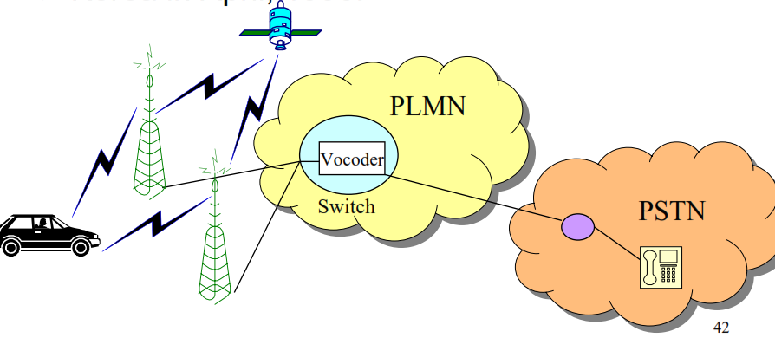
Cellular Telephony…
EIA/TIA IS-95 Digital Cellular System .
Qualcomm cdmaOne in USA since 1996 and Korea in April, 1996.

Slide 30
Cellular Telephony…
CDMA/DSSS for the air interface.
A shared 1.25 MHz channel bandwidth
User signals distinguished with different codes
MSs links to many BSs during phone calls.
No cell plan question
GPS for synchronization of BSs
Interference-based capacity (soft capacity)
The capacity of IS-95 is 3-6 times of IS-136
system, and 10 times of AMPS.
IS-41 for core network
Advanced Radio Resource.

Slide 31
Cellular Telephony…
Cellular Characteristics
The characteristics of the cellular system:
      Support high mobility
      Large coverage area
      High transmission power of BS and handset
      High signal process power (for handset)
      Low voice quality
      High network complexity
  Microcell is developed for:
      Low transmission power
      Low base station cost
      Increase capacity

Slide 32
Third-Generation Wireless System
Generations of Wireless Systems
First Generation System: AMPS
    Analog voice calls
Second Generation Systems:
GSM, IS-136, IS-95, and low-tier systems
Digital speech with low-bit-rate data services
Third-Generation:
Better system capacity
High-speed and wireless Internet access (to
2Mbps)
Wireless multimedia services (audio and video)

Slide 33
Third-Generation Wireless Systems
2.5G: GPRS and EDGE
Bridge 2G into 3G
The new features for 3G includes: High bit rates, QoS, Bit rates dependent on distance
Asynchronous Transfer Mode (ATM) backbone
Wideband CDMA (DS-CDMA FDD), SCDMA and cdma2000 (multi-carrier FDD) for air interface

